Slide 1

AI for Engineers: Introduction to Machine Learning
Mina Farmanbar
Associate Professor, University of Stavanger
for engineers

Slide 2
Artificial intelligence (AI)
Artificial intelligence (AI), a branch of computer science, is the process of simulating human intelligence with machines.
Recognizing patterns, making decisions, experiential learning, and natural language processing are the tasks that can be done using AI.

Slide 3






Artificial Intelligence (AI)
AI is used in many industries driven by technology, such as health care, finance, and transportation.

Slide 4
Artificial intelligence (AI)
Every time you shop online, search for information on Google, or watch a show on Netflix, you interact with a form of artificial intelligence (AI).
From factory workers to engineers, AI is quickly impacting jobs.
Learning AI can help you understand how technology can improve our lives through products and services.

Slide 5
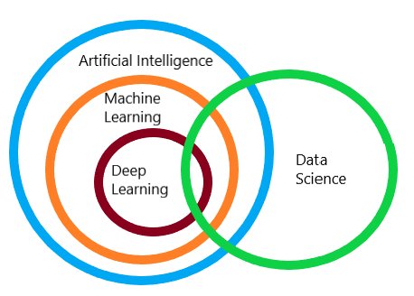
Machine Learning (ML)
The easiest way to explain the difference between artificial intelligence and machine learning is by saying, ‘All ML is AI, but not all AI is ML.’

Slide 6
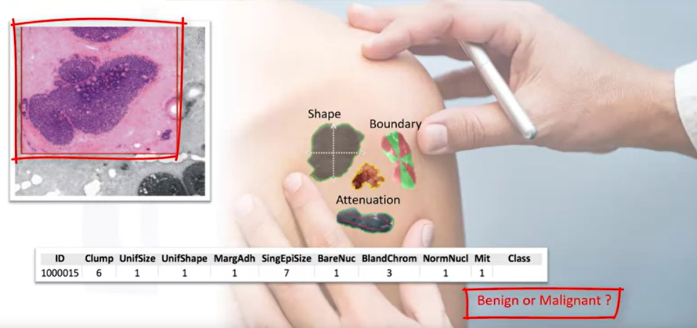
Is this a benign or malignant cell?
https://miro.medium.com/v2/resize:fit:720/format:webp/1*nudxWpwbJqS1gkhqNs7lyg.png

Slide 7
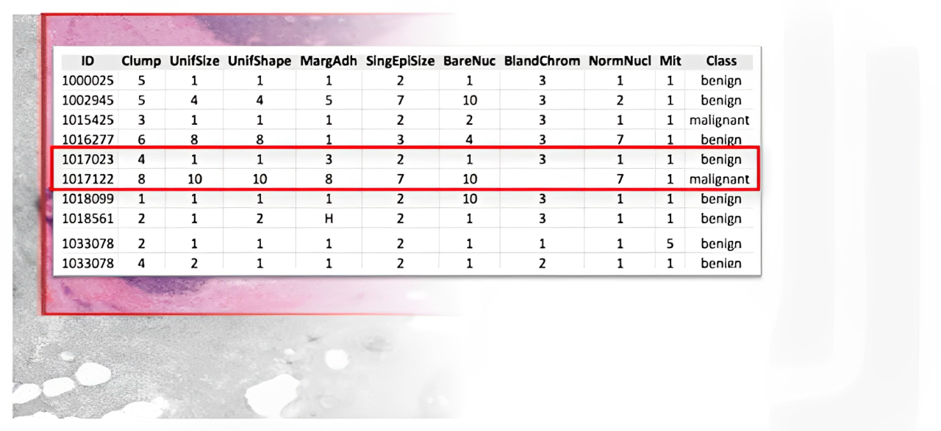
Is this a benign or malignant cell?
https://miro.medium.com/v2/resize:fit:720/format:webp/1*nudxWpwbJqS1gkhqNs7lyg.png

Slide 8
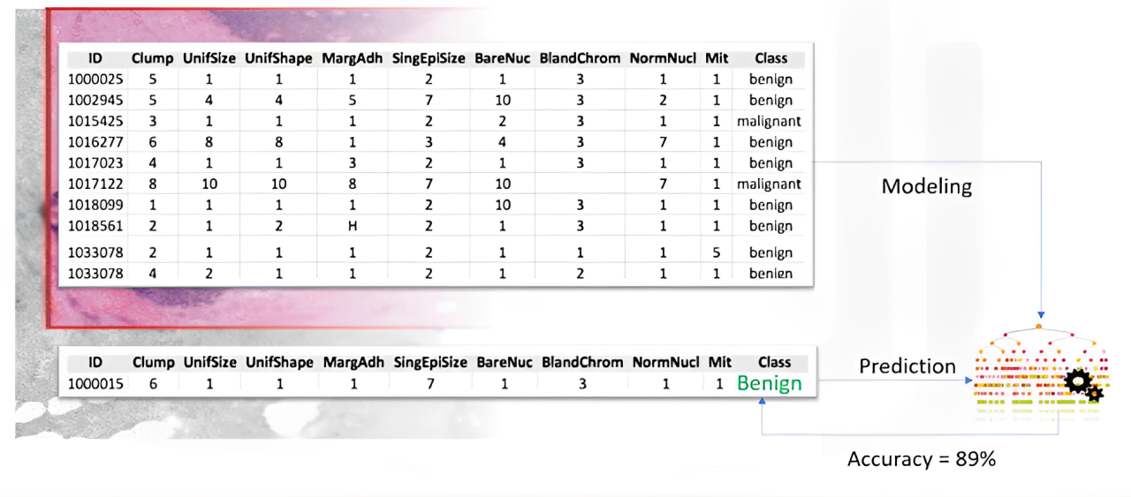
Is this a benign or malignant cell?
https://miro.medium.com/v2/resize:fit:720/format:webp/1*nudxWpwbJqS1gkhqNs7lyg.png

Slide 9
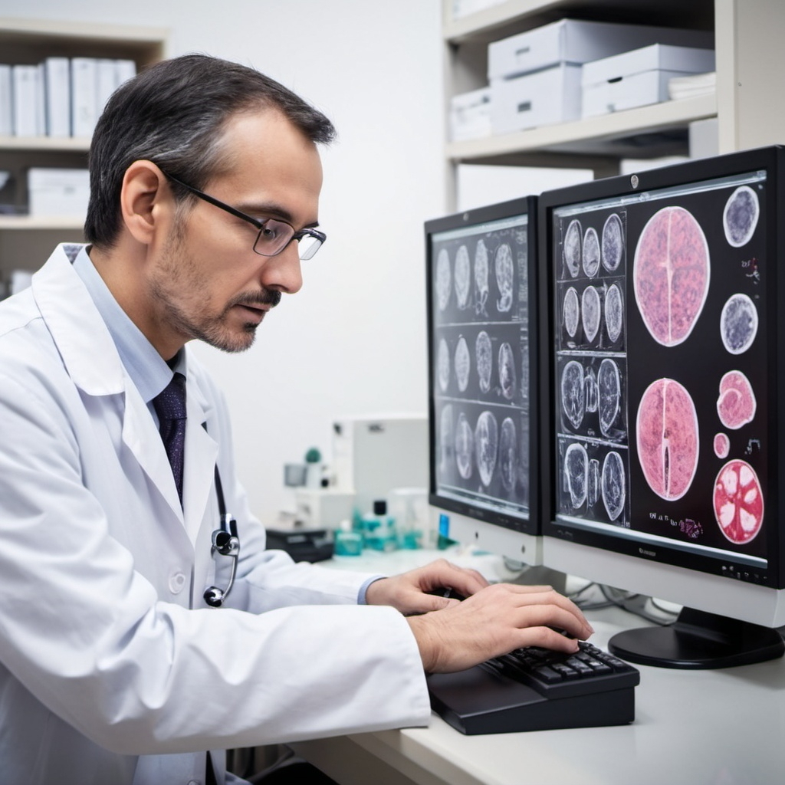
This process is called machine learning!
It is the way that a machine learning model can do a doctor’s task or at least help that doctor make the process faster.
AI-generated. DALLE2, 2024

Slide 10
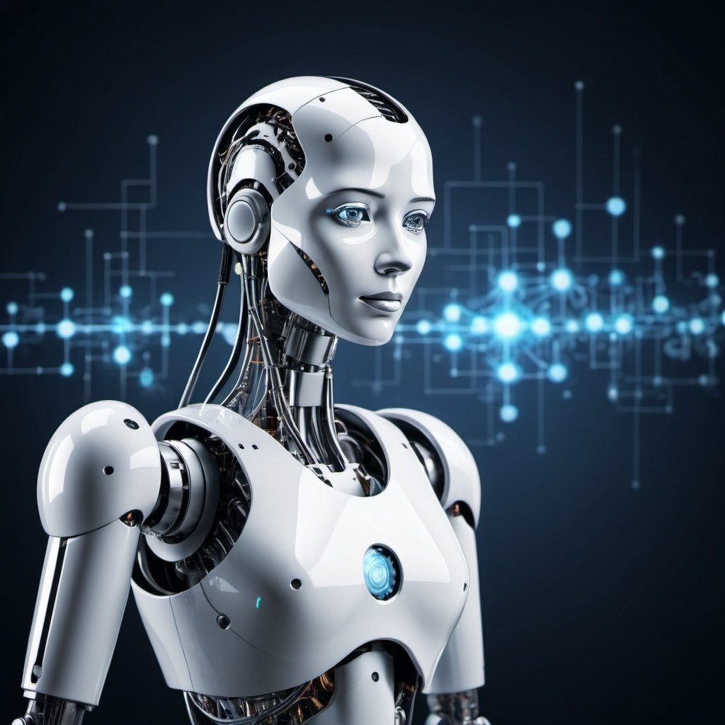
Machine Learning (ML)
Machine learning (ML) is a branch of Artificial Intelligence (AI) and computer science that focuses on the using data and algorithms to enable AI to imitate the way that humans learn, gradually improving its accuracy.
AI-generated. DALLE2, 2024

Slide 11
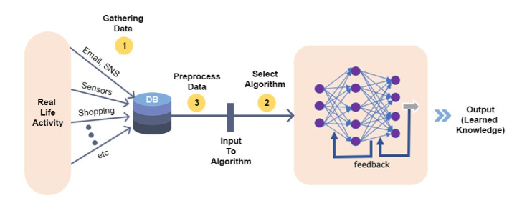
Machine Learning process flow
2. Acquire & Explore Data
4. Model validation
https://www.analytixlabs.co.in/blog/wp-content/uploads/2021/04/blogs-banner-5b.jpg
1. Define Project Objective
3. Model Building

Slide 12
Types of Learning
Supervised machine learning
Unsupervised machine learning
Semi-supervised machine learning
Reinforcement learning

Slide 13
Supervised Machine Learning (ML)
In supervised machine learning, algorithms are trained on labeled data sets that include tags describing each piece of data.
In other words, the algorithms are fed data that includes an “answer key” describing how the data should be interpreted.

Slide 14
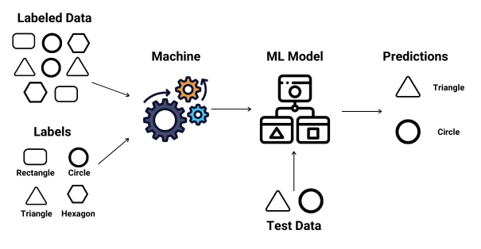
Supervised Machine Learning (ML)
https://miro.medium.com/v2/1*Iz7bCLrPTImnBDOOEyE3LA.png
Prediction
Classification

Slide 15
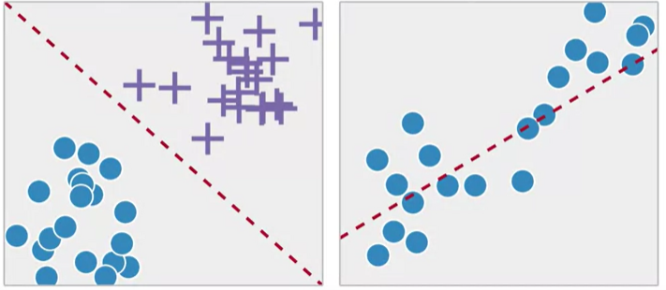
Types of Supervised Learning
https://www.researchgate.net/publication/326175998/figure/fig9/AS:644582983352328@1530691967314/Classification-vs-Regression.png
Classification
Regression

Slide 16
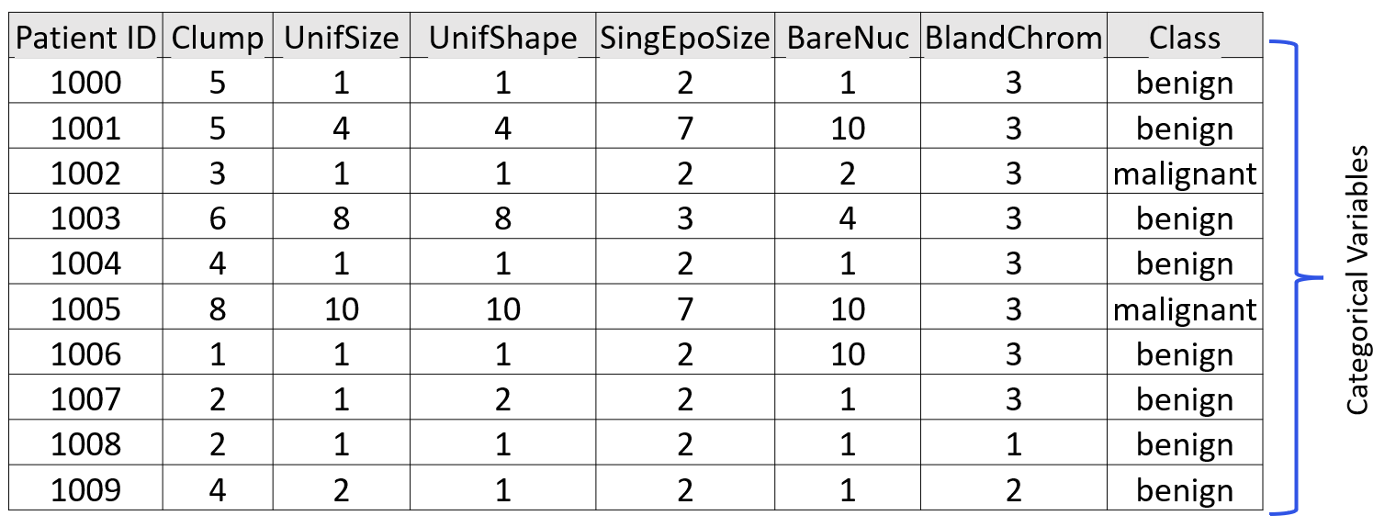
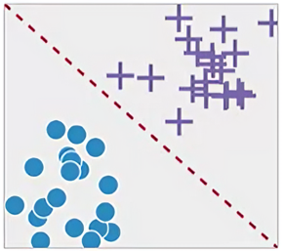
Classification
It is the process of predicting discrete class labels or categories.

Slide 17
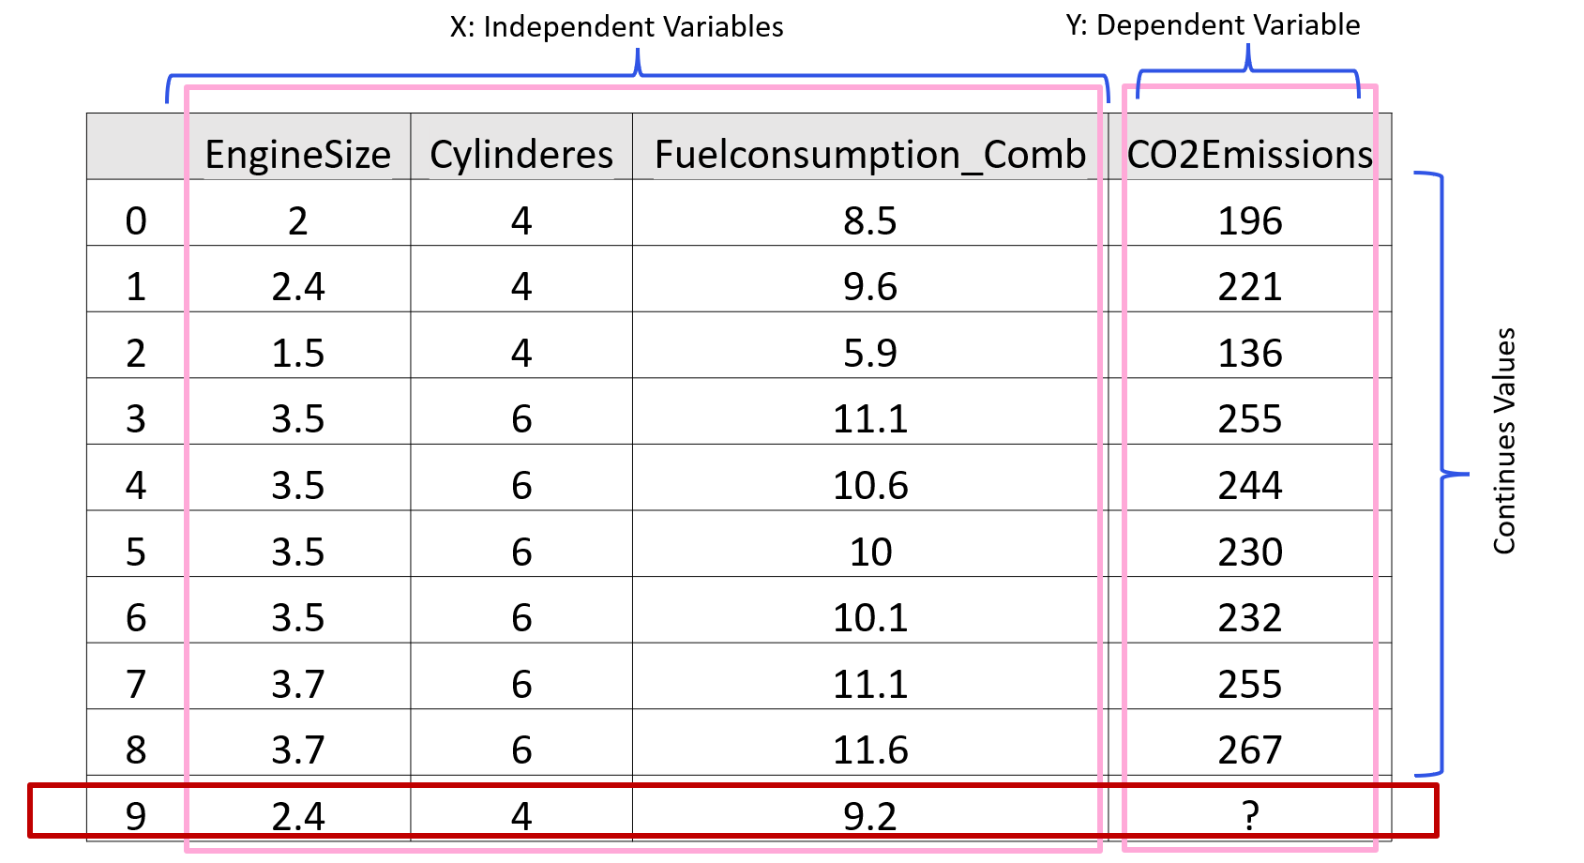
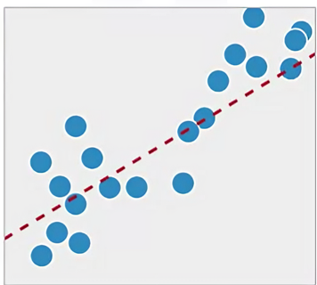
Regression
Regression is the process of predicting a continuous value as opposed to predicting a categorical value in classification.

Slide 18
Unsupervised Machine Learning (ML)
Unsupervised machine learning uses unlabeled data sets to train algorithms.
In this process, the algorithm is fed data that doesn't include tags, which requires it to uncover patterns on its own without any outside guidance.

Slide 19
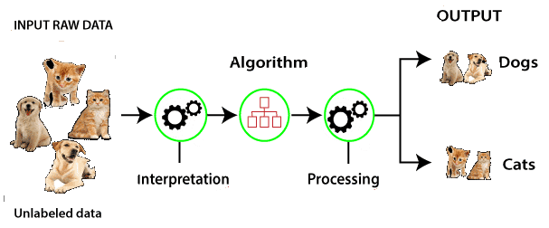
Unsupervised Machine Learning (ML)
https://tutorialforbeginner.com/images/tutorial/unsupervised-machine-learning-1.png
Clustering
Association
Principal Component Analysis

Slide 20
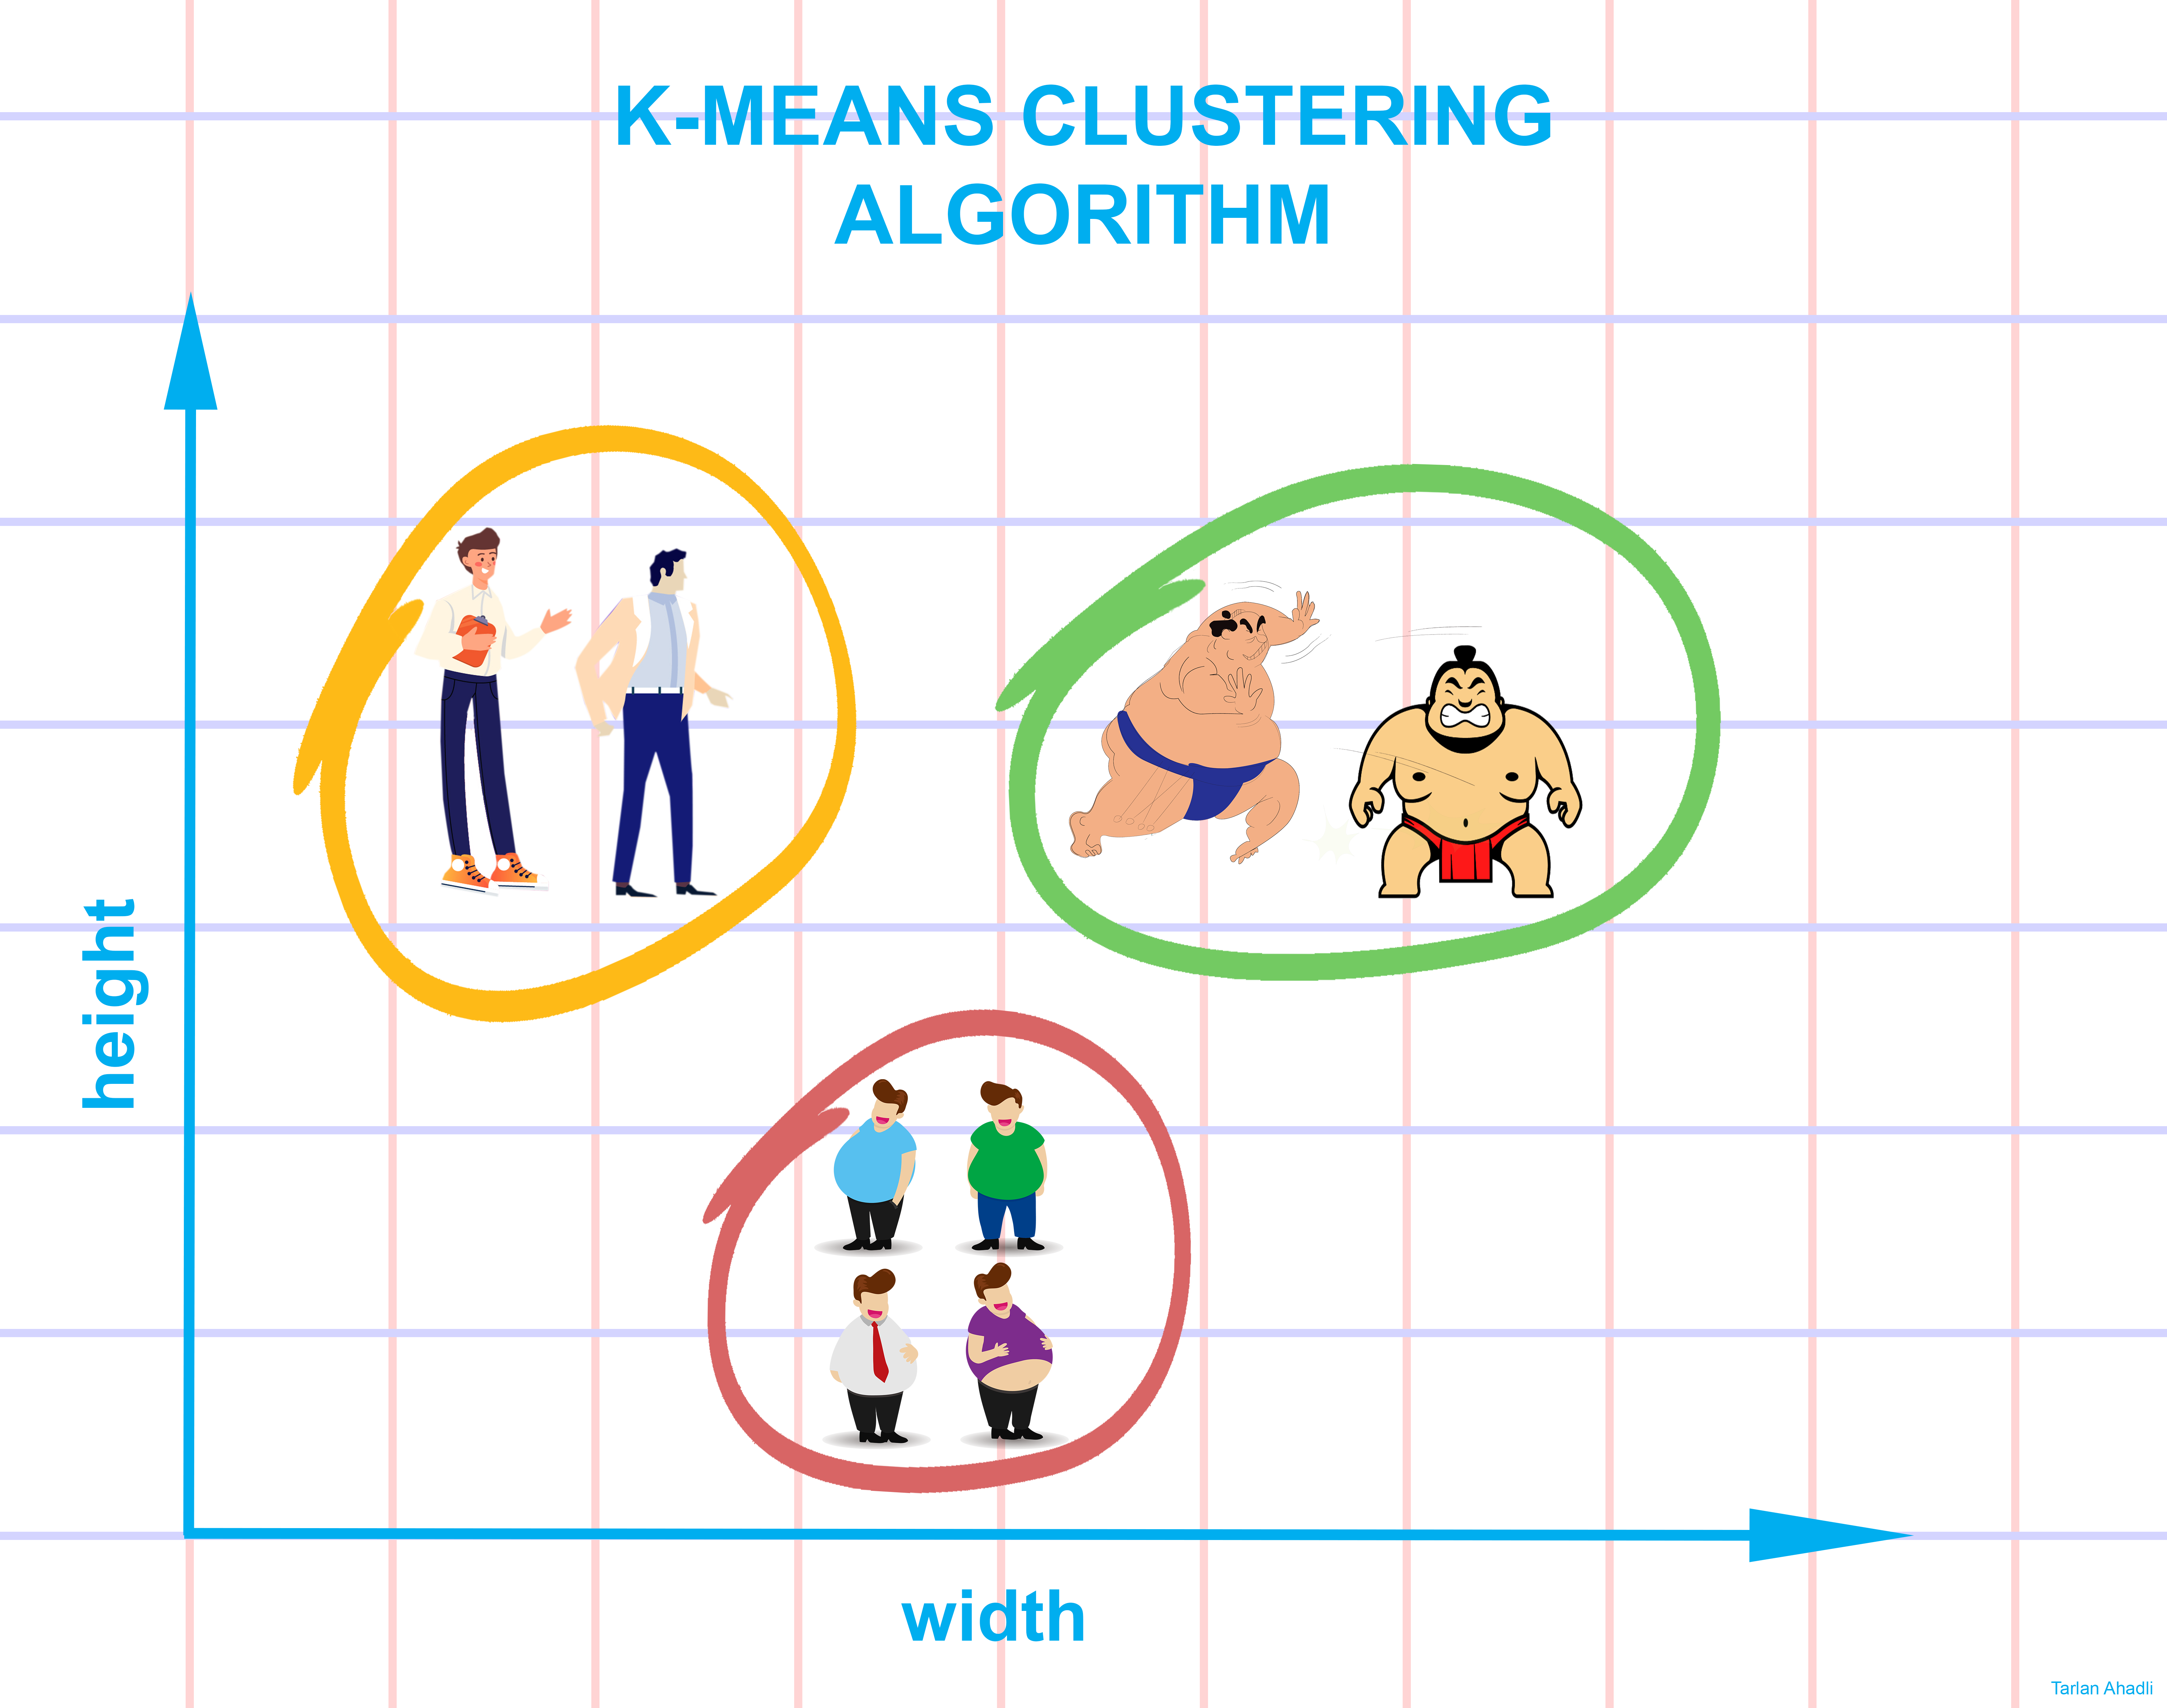
Clustering
Clustering is grouping of data points or objects that are somehow similar.
https://miro.medium.com/max/12094/1*IXGsBrC9FnSHGJVw9lDhQA.png

Slide 21
Semi-supervised Machine Learning (ML)
Semi-supervised machine learning uses both unlabeled and labeled data sets to train algorithms.
Generally, the process begins by providing the algorithm with a small amount of labeled data to guide its initial learning.
Subsequently, much larger quantities of unlabeled data are introduced to refine and complete the model.

Slide 22
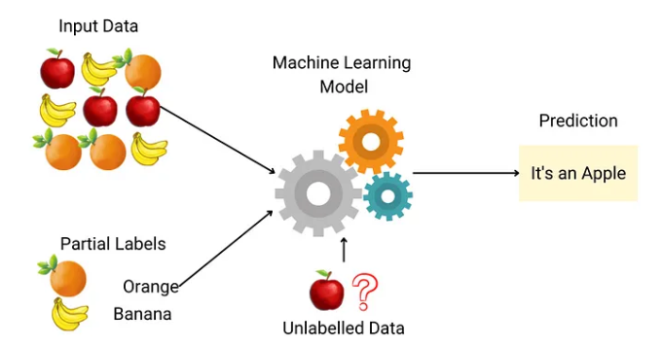
Semi-supervised Machine Learning (ML)
https://miro.medium.com/v2/resize:fit:1400/1*snZhMEQFhoJwbM5c0CPOAw.png
Prediction
Classification

Slide 23
Reinforcement Learning
Reinforcement learning uses trial and error to train algorithms and create models.
During the training process, algorithms operate in specific environments and then are provided with feedback following each outcome.
Much like how a child learns, the algorithm slowly begins to get an understanding of its environment and begins to optimize actions to achieve particular outcomes.

Slide 24
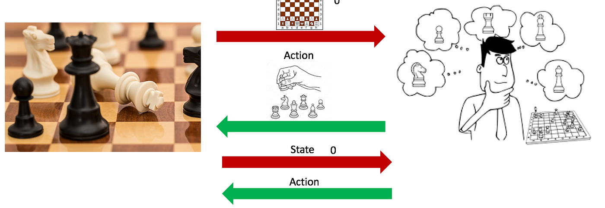
Reinforcement Learning
https://miro.medium.com/v2/resize:fit:1400/1*cmB6q5HINYG4kIQJKMFFuw.png

Slide 25
Major Machine Learning Techniques
Regression
Predicting continues values
Classification
Predicting the item class
Clustering
Finding the structure of data; summarization

Slide 26
Major Machine Learning Techniques
Anomaly Detection
Discovering abnormal and unusual cases
Dimensionality Reduction
Reducing the size of data (PCA)
Recommendation Systems
Recommending items

Slide 27
Summary
This video reviewed
Machine learning topics, basic concepts
Workflow of machine learning, the most common methods
Types of machine learning
Algorithms of machine learning, and applications of machine learning.
Notes:
https://anujdutt9.github.io/linear-regression-from-scratch

Slide 28
Thank you
Mina Farmanbar
mina.farmanbar@uis.no

